Slide 1
Pricing the Ride: How Clean Data Turned 500,000 Trips into Three Product Decisions
Uber Fare Prediction
Prepared by: Esraa Elgebaly

Slide 2
Three data problems, three fixes
PROBLEM 1 · IMPOSSIBLE VALUES
PROBLEM 2 · ZERO DISTANCE
PROBLEM 3 · EXTREME FARES
What we saw
What we saw
What we saw
$0 or negative fares, 0 passengers, missing GPS locations.
Distance = 0 km, yet fares up to $100.
Fares up to $500, while 99.9% are below $80.
Fix
Fix
Fix
Removed them.
Removed trips with distance 0.
Removed fares above $80.
Why this fix
Why this fix
Why this fix
They cannot be real trips, and the true values are unknown, so repairing them would invent data. Only 2.3% of trips.
A linear model reads 0 km as a cheap trip, so these rows mislead it. The real distance is unknown, so filling it would be a guess.
Capping at $100 turns every extreme fare into a fake $100 trip. A limit of $80 keeps real airport trips ($45–57).
488,316 real trips kept
R² 0.618 → 0.688
R² 0.688 → 0.816
Same model, cleaner data: R² 0.618 → 0.816, and the error (RMSE) dropped from $5.90 to $3.92.

Slide 3
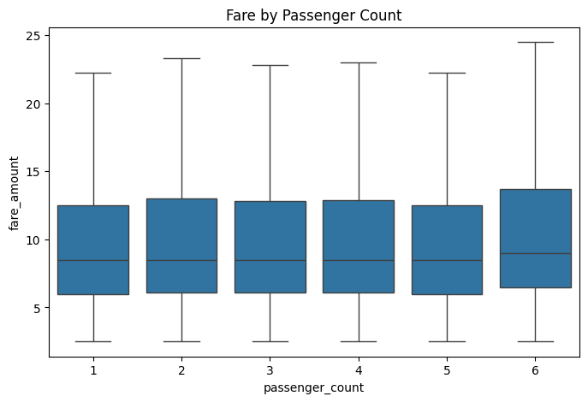
Is higher Passenger higher price?
Result: passenger count barely changes the fare. Only trips with 6 passengers cost a little more.
1 TO 5 PASSENGERS: ALMOST THE SAME
The typical fare (median) is about $8.50 for every group, and most trips cost between $6 and $12.50.
WHY DO 6 PASSENGERS PAY MORE?
Their typical fare is about $9.50. I tested two ideas:
Longer trips? No. Every group travels about 2.2 km.
More expensive hours? No. At the same hour, they still pay $0.20–$0.40 more per km in 23 of 24 hours.
So, 6 passengers really pay about 6% more per km ($4.04 vs about $3.80). That is only about $0.45 per trip, a very small difference.
Why a boxplot? Passenger count is a group (1 to 6) and fare is a number. A boxplot shows the typical fare and the spread for each group, so they are easy to compare.
Uber Fare Prediction · 01

Slide 4
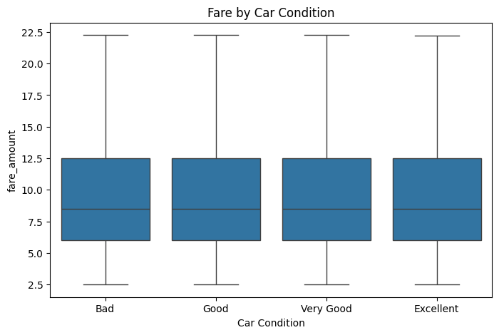
Does car condition influence the fare amount?
Result: no. Riders pay the same whether the car is in bad or excellent condition.
HOW WE CONFIRMED IT
The plot: the four boxes look the same.
Typical fare: exactly $8.50 in every group.
Fare per km: $3.819 to $3.827, less than 1 cent apart.
A HINT THE COLUMN IS RANDOM
Each group has about 120,000 trips, almost exactly 25% each. A real taxi fleet would not be split this evenly.
WHAT I GET
Distance and time set the price, not the car.
The model can likely drop this column.
Weather and traffic may be random too, so we check them the same way.
Why a boxplot? Car condition is a group (Bad to Excellent) and fare is a number. A boxplot shows the typical fare and the spread for each group, so they are easy to compare.

Slide 5
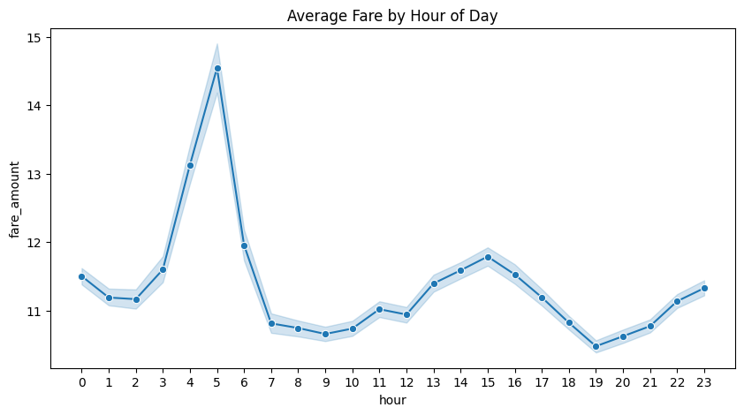
At what hour of the day are fares typically highest?
Result: fares peak at 5 a.m. because trips are longer then, not because each km costs more.
WHAT THE FIGURE SHOWS
Peak: 5 a.m. (about $14.55), rising from 3 a.m.
Lowest: 7 p.m. ($10.48) and 7–10 a.m. (about $10.70).
Small second rise: 1–4 p.m. (about $11.80 at 3 p.m.).
Shaded band: widest at 4–5 a.m., where there are fewest trips (4,686), so less certain.
WHY? LONGER TRIPS, CHEAPER KM
Time | Typical distance | Fare per km
4–5 a.m. | 3.1–3.2 km (longest) | $3.09–3.12 (cheapest)
Midday | 1.9 km (shortest) | $4.1–4.2 (priciest)
Why a line plot? Hours are in time order and the question is how the fare changes through the day. Note: the y-axis starts near $10, so the real gap is about $4.
WHAT I GAIN
Hour affects the fare, but not in a straight line, test a better hour encoding.
Real traffic lives in the hour: a midday km costs ~35% more than at dawn.

Slide 6
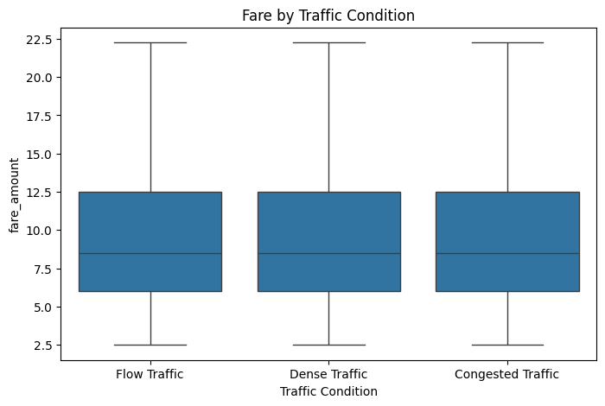
Does traffic change the fare?
Result: no, and that is suspicious. Real traffic should make a trip more expensive.
HOW WE CONFIRMED IT
The plot: the three boxes look the same.
Typical fare: exactly $8.50 at every traffic level.
Fare per km: $3.820 to $3.824, less than half a cent apart.
Trips: about 160,000 per level, a third each.
Explains: 0.0% of fare differences (distance: 79.5%).
THE CONTRADICTION
Real traffic does show up in the data: fare per km is about $3.10 early morning and $4.20 at midday (~35% more). This column shows almost 0%.
WHAT I GAIN
The real traffic effect is captured by the hour, not this column.
The column is likely random, so the model can drop it (to be tested).
Never trust a column because of its name: test it.
Why a boxplot? Traffic is a group and fare is a number, so we compare one box per group. All three boxes match the whole dataset: $6, $8.50, $12.50.

Slide 7
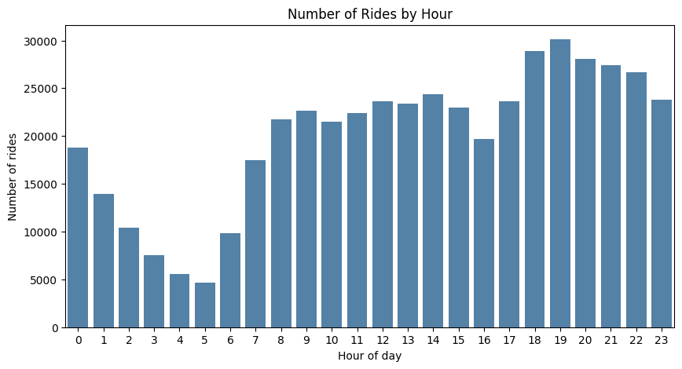
When do people ride the most?
Result: demand peaks at 6–8 p.m. and is lowest at 4–5 a.m., about 6× fewer rides.
WHAT THE CHART SHOWS
Peak: 7 p.m. (30,120 rides).
Lowest: 5 a.m. (4,686 rides).
Daytime: rises 7–9 a.m., then steady at ~22,000–24,000.
Dip at 4 p.m.: 19,679 rides, likely the driver shift change.
LINK WITH Q3: DEMAND VS PRICE
Hour | Rides (Q6) | Average fare (Q3)
5 a.m. | Fewest (4,686) | Highest ($14.55)
7 p.m. | Most (30,120) | Lowest ($10.48)
Why a count plot? We count trips per hour instead of averaging a value. Each of the 24 hours gets its own bar, so peaks are easy to spot.
WHAT I GAIN
Fewer rides ≠ cheaper: dawn trips are rare but long.
Few trips at dawn make those averages less certain; evening needs the most drivers.

Slide 8
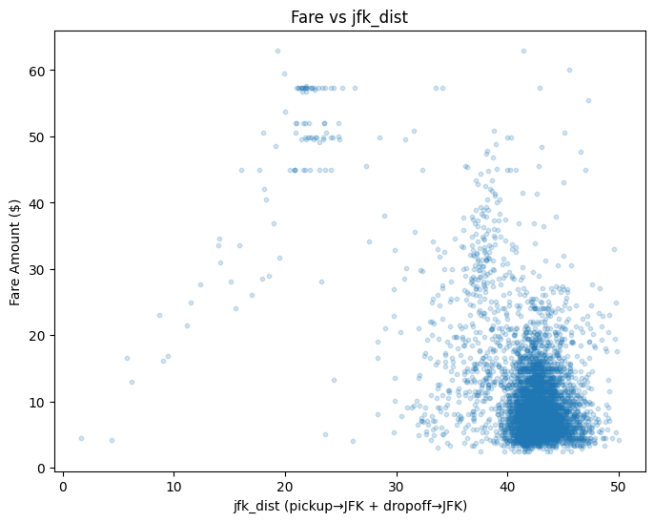
Are airport rides more expensive?
Result: JFK trips form their own group at $45–57, versus about $5–15 for normal city trips.
HOW TO READ jfk_dist
It adds two distances: pickup → JFK + dropoff → JFK.
Airport → downtown: 0 + 21 = 21 km (same as the trip).
City trip: 20 + 20 = 40 km (far from the airport).
WHAT THE FIGURE SHOWS
Big cloud near 40: normal city trips, mostly $5–15.
Separate group near 21: JFK trips, in flat rows at about $45, $50, $52 and $57.
Flat rows = a fixed price: a 20 km and a 24 km airport trip cost the same.
WHAT I GAIN
Airport trips are a separate group, not a gradual “closer = pricier” trend.
A fixed price breaks the model’s “$2.29 per km” rule, add an is_jfk feature and test it.
Why a scatter plot? jfk_dist and fare are both numbers; each dot is one trip, so separate groups become visible.

Slide 9
Turning Insights into Action: 3 Priorities
1. Launch upfront price estimates
Distance explains ~80% of the fare, and the model is off by only about $2 on average. Showing riders a price range before they book builds trust and uses what the model already does well.
2. Make airport rides a separate product with a fixed price
JFK trips are a flat $45–57 fare that distance can't explain, and they are the model's biggest error. A fixed airport price, dedicated pickup zones and pre-booking make these rides easier to sell and plan, and remove the largest source of wrong estimates.
3. Match drivers to demand
Demand peaks at 7 p.m. (30,120 rides) and dips at 4 p.m. during the shift change. More drivers in the evening and staggered shift changes mean fewer riders waiting or leaving the app at the busiest times.

